Slide 1

Department of Information Technology
TE IT Seminar Review I
Group No 4
Group Members :
4302 Akshit Kotnala
4304 Amit
4314 Ashish Sable
Guide : Prof Sandeep Samleti

Slide 2
Contents
Seminar Topic
Literature Survey
Block Diagram
Methodologies used
Objective
Conclusion
References

Slide 3
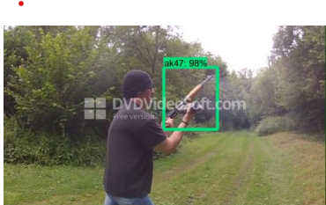
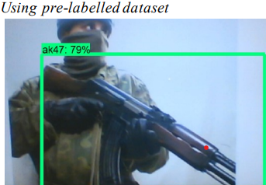
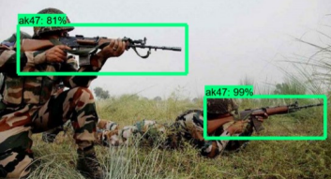
Seminar Topic
Use of AI in best Weapon Selection and Autonomous Engagements

Slide 4
Sr.No | Paper Name/title | Source of paper/Year | Methodology | Future Scope/shortcomings | Findings
1. | Design of Weapon Detection System | IEEE Xplore 2022 | Speeded Up Robust Features (SURF) algorithm Hardware: ARM LPC2148 Software: MATLAB https://ieeexplore.ieee.org/document/9885601 | Improvements Needed for Asymmetrical Objects More Accurate Matching: Feature matching | Effective Detection: The system can detect symmetrical objects like razor blades and guns efficiently. Challenges with Asymmetrical Objects: Detecting asymmetrical objects (like pistols) proved less effective due to fragmented feature recognition.
2 | Weapon Recognition in CCTV Videos: Deep Learning Solutions | IEEE Xplore 2024 | Combination of VGG-16 or NASNetMobile for feature extraction and ConvLSTM(Convolutional Long Short-Term Memory) for processing temporal data in video frames. https://ieeexplore.ieee.org/document/10493569 | Need for High-Performance Hardware: The system requires a powerful GPU for real-time processing. | High Accuracy: The proposed method achieved 96.69% accuracy Best Model: YOLOv4 performed the best with 91.73% mAP, being both fast and accurate.

Slide 5
Sr.No | Paper Name/title | Source of paper/Year | Methodology | Future Scope/shortcomings | Findings
3 | Weapon Detection using Artificial Intelligence and Deep Learning for Security Applications | IEEE Xplore 2020 | SSD (Single Shot Detector): Detects objects quickly without region proposal steps, making it faster. Faster R-CNN: Uses region proposals, making it slower but more accurate. https://ieeexplore.ieee.org/document/9155832 | Hardware Dependency: Requires high-end GPUs and specialized hardware like DSP and FPGA kits for larger datasets. | Speed vs. Accuracy:SSD: Faster (0.736 s/frame), but less accurate (73.8% accuracy). Faster R-CNN: Slower (1.606 s/frame), but more accurate (84.6% accuracy).
4 | AI in Defence and Ethical Concerns | IEEE Xplore 2024 | Literature Review: Examined existing AI applications in defense and ethical concerns globally. Comparative Analysis: Compared AI applications in Indian defense with those in other countries (e.g., U.S.). https://ieeexplore.ieee.org/document/10493592 | Development of a national AI strategy for defense.Collaboration with international AI ethics standards. | AI Benefits: AI can enhance defense with precision targeting, Autonomous Weapons Systems (AWS) can make lethal decisions without human intervention.

Slide 6
Sr.NO | Paper Name | Source of paper/Year | Methodology | Future scope/Shortcoming s | Findings
1. | Weapon_Detection_System_for_the_Prevention_of_any_Potential_Crime_Using_Artificial_Intelligence | IEEE EXPLORE Year of publication-2023 https://ieeexplore.ieee.org/document/10541543 | The system uses the YOLO V3 algorithm integrated with TensorFlow to detect weapons in real-time surveillance footage. | Implementing the system in real-world environments like airports, schools, and shopping malls to prevent crimes. The system’s performance is highly dependent on the quality and variety of training data. | The system achieved high accuracy in detecting common handheld weapons in controlled environments. It demonstrated real-time performance, allowing immediate notification to authorities when a weapon is detected, thus enhancing public safety.
2. | Weapon_Detection_For_Security_Using_The_Yolo_Algorithm_With_Email_Alert_Notification | IEEE EXPLORE Year of publication-2024 https://ieeexplore.ieee.org/document/10616365 | The weapon detection system employs YOLOv8 to process images, video files, and live streams. NMS(Non Maximum Supression) | The algorithm could also be improved to detect more varied weapons in complex environments, such as crowded public areas. The reliance on email notifications for alerts introduces a delay in response times | The system achieved 94% accuracy in identifying weapons, making it reliable for use in high-security environments.

Slide 7
Sr.NO | Paper Name | Source of paper/Year | Methodology | Future scope/Shortcoming s | Findings
3. | Integrating Artificial Intelligence into Weapon Systems | ARXIV Year of publication-2019 https://arxiv.org/abs/1905.03899 | The paper examines how AI can be integrated into military weapon systems, focusing on AI-enhanced decision-making in the battlefield. | Developing AI systems that can make ethically aligned decisions under complex battlefield conditions. | Fully autonomous systems present both opportunities and risks. While AI can enhance decision-making speed and accuracy, it introduces new cybersecurity vulnerabilities and ethical dilemmas.
4. | A Comparison of Six Convolutional Neural Networks for Weapon Categorization | IEEE EXPLORE Year of publication-2022 https://ieeexplore.ieee.org/document/9932092 | Six CNN architectures (InceptionV3, ResNet50, ResNet101, VGG-16, Inception-ResNet-V2, SqueezeNet) were trained and tested on weapon classification tasks | Exploring the performance of newer and more complex CNN models such as EfficientNet or Transformers.. In real-world applications, the imbalanced nature of data and unexpected scenarios may lead to lower accuracy. | InceptionV3 and Inception-ResNet-V2 performed the best, achieving a 99% accuracy in weapon categorization. Transfer learning significantly reduced training time and improved overall accuracy.

Slide 8
Sr.No | Paper Name/title | Source of paper/Year | Methodology | Future Scope/shortcomings | Findings
1. | A method for ethical AI in defence | ELSEVIER 2022 | They involved embedding ethics-by-design principles, responsible research, and innovation-aligned approaches during development, ensuring stakeholder collaboration and high translation readiness levels. | For future work it includes enhancing transparency, accountability, ethical considerations, and adaptability. Shortcomings may involve bias, security, and ethical dilemmas. | The findings highlight the importance of ethics-by-design and responsible research in developing trusted autonomous systems like Athena AI. Key themes include collaboration, transparency, accountability, and ensuring ethical principles at high technology readiness levels. Keywords: responsible research, ethics-by-design, trusted autonomous systems, Athena AI, collaboration, transparency, accountability, Defence technology.
2. | THE USE OF ARTIFICIAL INTELLIGENCE AND AUTONOMOUS WEAPON SYSTEMS IN MILITARY OPERATIONS | SCIENDO 2024 | This includes leveraging artificial intelligence to process vast data rapidly for decision-making, target identification, adversary prediction, and minimizing human involvement in high-risk operations while ensuring efficiency. | They improving AI reliability, enhancing human oversight, and refining ethical frameworks. Shortcomings involve potential loss of control, misuse risks, and challenges in ensuring accountability and civilian protection. | AI and autonomous weapon systems enhance military efficiency and decision-making, but raise ethical concerns regarding control and misuse. Key aspects include efficiency, autonomy, ethical challenges, and strategic benefits. Keywords: AI, autonomous weapon systems, military efficiency, decision-making, ethical challenges, control, misuse, strategic benefits.

Slide 9
Sr.No | Paper Name/title | Source of paper/Year | Methodology | Future Scope/shortcomings | Findings
3. | Artificial Intelligence, Weapons Systems and Human Control | E-international Relation 2021 | The study employs qualitative analysis of existing research, case studies of current AWS, and evaluation of ethical and legal implications regarding human-machine interaction in warfare. | Further research should explore the evolving role of AI in AWS, focusing on regulatory frameworks and maintaining meaningful human control in increasingly autonomous systems. | AI-driven autonomous weapons systems impact human control and remote warfare, challenging ethical and legal norms. Key aspects include autonomy, remote warfare, human-machine interaction, and regulatory issues. Keywords: AI, autonomous weapons systems, remote warfare, human control, ethical implications, legal issues, human-machine interaction, technology in warfare.
4. | AI-based small arms firing skill evaluation system in the military domain | KeAi 2023 | The study designs and develops an AI-based small arms firing evaluation system using image processing, machine learning, fuzzy systems, and linear regression to automate target evaluation and performance prediction. | Explore integration with real-time feedback systems and enhancement of accuracy through advanced AI algorithms, incorporating broader military training scenarios for comprehensive evaluation. | AI-based evaluation improves accuracy in small arms firing by automating target scoring and performance prediction. Key aspects include image processing, machine learning, fuzzy systems, and linear regression. Keywords: AI, small arms firing, image processing, machine learning, fuzzy systems, linear regression, target evaluation, military training, performance prediction, automation.

Slide 10
Sr.No | Paper Name/title | Source of paper/Year | Methodology | Future Scope/shortcomings | Findings
5. | Autonomous Weapons Systems, Artificial Intelligence, and the Problem of Meaningful Human Control | PJCV 2021 | The article employs theoretical analysis to assess human control in AI-supported lethal autonomous weapon systems (LAWS), examining technological limitations and moral agency implications through existing literature and Wiener’s warnings. | Further research should investigate solutions for maintaining human moral agency in LAWS and explore regulatory frameworks to address the ethical challenges posed by advanced AI technologies. | Human control in AI-supported LAWS is increasingly compromised by technological features, limiting moral agency. Key aspects include AI, control, moral responsibility, weapon systems, and ethical challenges. Keywords: AI, autonomous weapons systems, human control, moral responsibility, ethical implications, technological limitations, lethal autonomous weapon systems, regulation.

Slide 11
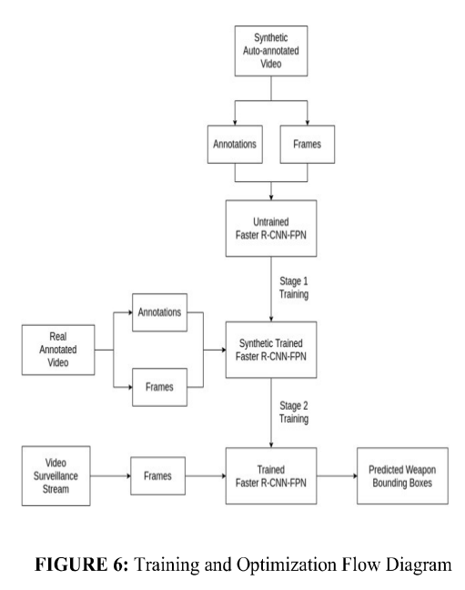
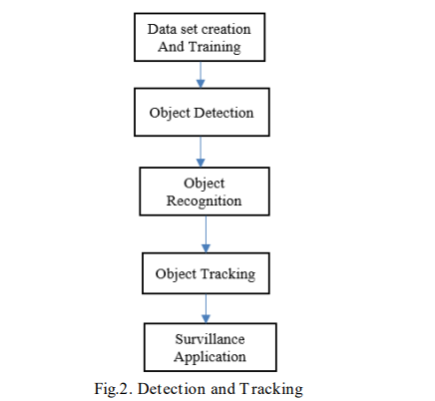
Block Diagram
https://ieeexplore.ieee.org/document/9885601
https://ieeexplore.ieee.org/document/10493569

Slide 12





METHODOLOGIES USED :-
Speeded Up Robust Features (SURF) algorithm
Hardware: ARM LPC2148
VGG-16 or NASNetMobile for feature extraction
ConvLSTM (Convolutional Long Short-Term Memory) for processing temporal data.
Ai in Weapon
Implementation Tools: OpenCV, Python, TensorFlow, NVIDIA GeForce GPU, COCO dataset, and self-created image dataset.
Comparative Analysis: Compared AI applications
SSD (Single Shot Detector): Detects objects quickly
Literature Review: Examined existing AI applications
Faster R-CNN: Uses region proposals

Slide 13
METHODOLOGIES USED:-
The YOLO V3 algorithm integrated with TensorFlow and CNN
Six CNN architectures (InceptionV3, ResNet50, ResNet101, VGG-16, Inception-ResNet-V2, SqueezeNet
YOLO V8 algorithm and NMS.

Slide 14
Objectives
05
Need for Regulatory Frameworks
04
Human-AI Collaboration
03
Ethical Considerations
02
AI's Impact on Military Efficiency
01
Understanding AI in Weapon Selection

Slide 15
Conclusion
AI enhances weapon selection with precision and speed.
Better Weapon Choices
01
AI automates tasks, boosting defense operations.
02
Improved Efficiency
Accountability, bias, and human control are key concerns.
03
Ethical Challenges
Clear algorithms and human oversight are crucial for responsible AI use.
04
Transparency & Oversight
05
Regulations Needed
Strong guidelines are essential to govern AI in defense.

Slide 16
References
H R Rohit et.al., “A Review of Artificial Intelligence Methods for Data Science and Data Analytics: Applications and Research Challenges,”2018 2nd International Conference on I-SMAC (IoT in Social, Mobile, Analytics and Cloud), 2018.
S. Pankanti et.al.,“Robust abandoned object detection using regionlevel analysis,”International Conference on Image Processing,2011.
Weapon Detection Using Artificial Intelligence And Deep Learning For Security Applications. (2023, May 26). International Research Journal Of Modernization In Engineering Technology And Science.
Deep Learning based Object Detection Methods: A Review. (2022, March 31 ). Medicon Engineering Themes.
Gawade, S., Vidhya, R., & Radhika, R. (2022). Automatic Weapon Detection for Surveillance Applications. SSRN Electronic Journal.
P. M Panchal, S. R Panchal and S. K Shah, "A Comparison of SIFT and SURF", International Journal of Innovative Research in Computer and Communication Engineering, vol. 1, no. 2, pp. 323-327, 2013.
Chetan Dhule, Rahul Agrawal, Sanjay Dorle, “Study of Design of IoT based Digital Board for Real Time Data Delivery on National Highway”, 6th International Conference on Inventive Computation Technologies (ICICT), 978-1-7281-8501-9/21/ 2021 IEEE, PP 841-844.
Rahul Agrawal, Dr. Preeti Bajaj, “EEG Based Brain state Classification technique using Support Vector Machine -A Design Approach”, 3rd International Conference on Intelligent Sustainable Systems (ICISS 2020) organized by SCAD Institute of Technology, Palladam, India from 03- 05, December 2020 (Indexed by IEEE) ISBN: 978-1-7281-7089- 3/20 2020 IEEE ,PP. 1523-1528.

Slide 17
Thank You

